Slide 1
Slides for Chapter 1
Note to Instructors
This Keynote document contains the slides for “Introduction”, Chapter 1 of Explorations in Computing: An Introduction to Computer Science and Python Programming.
The book invites students to explore ideas in computer science through interactive tutorials where they type expressions in Python and immediately see the results, either in a terminal window or a 2D graphics window.
Instructors are strongly encouraged to have a Python session running concurrently with Keynote in order to give live demonstrations of the Python code shown on the slides.
License
The slides in this Keynote document are based on copyrighted material from Explorations in Computing: An Introduction to Computer Science and Python Programming, by John S. Conery.
These slides are provided free of charge to instructors who are using the textbook for their courses.
Instructors may alter the slides for use in their own courses, including but not limited to: adding new slides, altering the wording or images found on these slides, or deleting slides.
Instructors may distribute printed copies of the slides, either in hard copy or as electronic copies in PDF form, provided the copyright notice below is reproduced on the first slide.
© 2015 John S. Conery

Slide 2
Introduction
What is Computer Science?
Computation
The Limits of Computation
Algorithms
A Laboratory for Computational Experiments

Slide 3
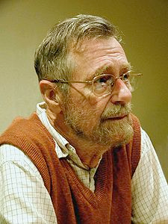
What is Computer Science?
From the title of the field, one might think computer science is “the study of computers”
A quote from a famous computer scientist:
“Computer Science is no more about computers than astronomy is about telescopes”
Edsger Dijkstra (1930 -- 2002)
If CS is not the study of computers, what is it?
To answer this question, let’s first ask what computers are, and what they can do -- then come back to the main question of “what is computer science?”

Slide 4
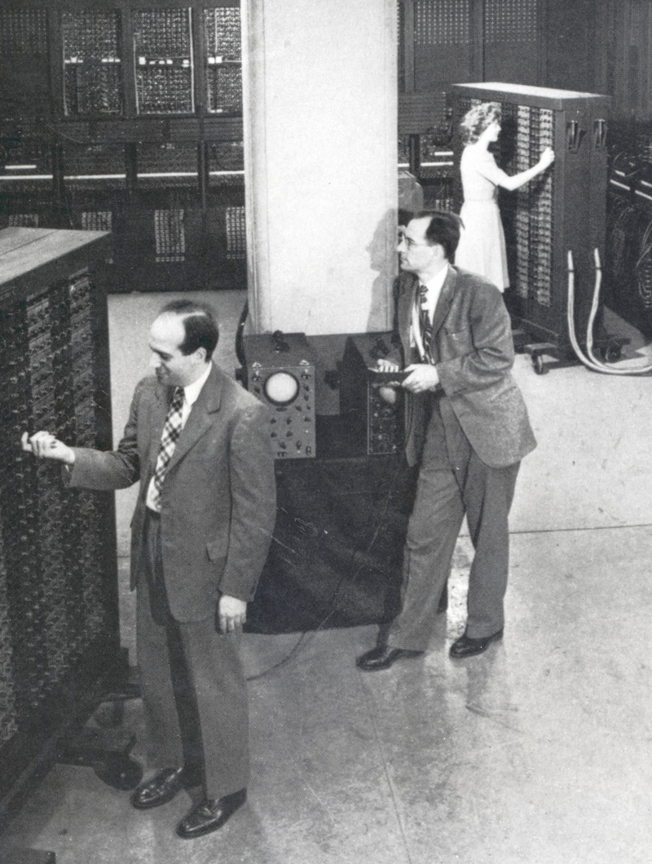
Electronic Brains
When computers first started being widely used in the 1950s the general public viewed them as “electronic brains”
they were huge, expensive, mysterious
found only in the largest corporate, government, or university labs
sci-fi movies exploited this “electronic brain” viewpoint
Why a “brain” instead of some other metaphor?
the calculations performed by computers were the sorts of things only highly trained people were able to do
example: compute the trajectory of a rocket
www.computerhistory.org

Slide 5
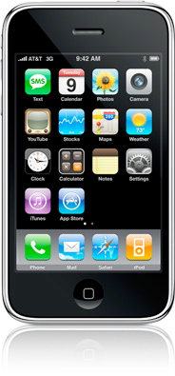
Appliances
Today computers are essential tools in modern society
Personal computers (desktops and laptops)
write papers, manage personal finances, ....
entertainment: games, video, audio, ....
Business computers
day-to-day operations: payroll, billing, ...
customer service: web sites, customer data, ...
Embedded computers
microchips used as controllers in cars, phones, buildings, ....
Supercomputers
large “number crunchers” used in scientific research and other areas
parallel processing: from a few dozen to a few thousand CPU chips

Slide 6
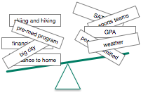
What Computers Can’t Do
One way to approach the question of “what is a computer?” is to look at some of the things we don’t expect a computer to be able to do
Problem 1: Choose a college or university to attend
Would you trust a computer to solve this problem for you?
several factors are involved, many of them hard to quantify
you don’t expect another person to solve this problem for you, either
the issue here is not the computer, it’s the nature of the problem
in order to “compute” the best choice you would need to be give a precise weight to each factor

Slide 7
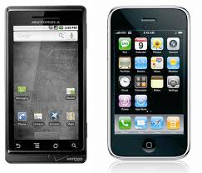
What Computers Can’t Do (cont’d)
Problem 2: Invite friends over to watch a DVD
It would be nice if our cell phones were more like personal assistants
pick up the phone, say “invite Erica and Katie over to watch a DVD”
your phone would negotiate with their phones to pick a time that works
this is the sort of thing humans can do (“have your people call my people...”)
Unlike the previous problem, this is an example of something humans can do that machines (so far) cannot
will a future computer be able to solve this problem?

Slide 8
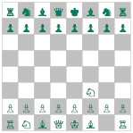
What Computers Can’t Do (cont’d)
Problem 3: The perfect game of chess
You might think it would be easy for a computer to win a game of chess
The rules of the game are simple, and it’s straightforward to write a program that would have a computer examine all possible moves
The problem: there are too many moves to consider
there are an estimated 10⁴³ possible games
a supercomputer checking 10¹² boards/sec would need 10²¹ years to look at them all
So here we have a new type of limitation: a practical limit
people are no better than machines at performing this task
grand masters do not consider all possible moves

Slide 9
What Computers Can’t Do (cont’d)
Problem 4: Non-computable functions
A famous problem in computer science is known as “the halting problem”
The goal: write a program that determines if another program is stuck
suppose you’re writing a paper and the pointer changes to the “busy” icon
it is impossible to write a “halt checker” to see if the word processor has crashed
This problem is related to paradoxes in logic (e.g. “this statement is false”)
a new type of limitation: a mathematical barrier
another example where people are no better than machines at solving the problem

Slide 10
Recap: Computational Limits
An interesting theme showed up on the previous slides
Some tasks that computers cannot perform are also impossible for humans
The difficulty is in the nature of the problem, not the person or thing trying to solve it
A problem might not be solvable by humans or computers because
some attributes are not quantifiable (quality of life at a university)
it is impractical (chess)
it is impossible (halt checker)
Problems that humans can solve but computers can’t are often described in terms of “intelligence”
natural language processing, planning, design, ...
an active area of CS research: artificial intelligence (AI)

Slide 11
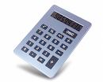
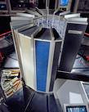
Computation
A computation is a sequence of well-defined operations that lead from an initial starting point to a desired final outcome.
note this definition does not include the word “computer”
a computation is a process that can be carried out by a person or a machine
the same computation might be carried out using any one of a number of different technologies

Slide 12
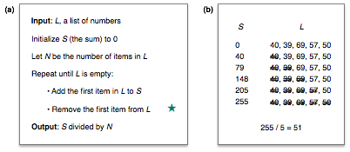
Example: Average Age
As an example of a computation, suppose a scientist wants to calculate the average of a set of data points
in this case “average” means “arithmetic mean”
method: compute the sum of the values, then divide by the number of data points
For a small data set one could use paper and pencil or a hand calculator
For larger data sets one would probably use a computer

Slide 13
An Old Idea
The idea that problems can be solved by following a detailed set of instructions is very old
ancient Greek, Persian, and Chinese philosophers all developed computational approaches to solving arithmetic problems
example: the Sieve of Eratosthenes, a method for finding prime numbers
Until the 1940s the word “computer” was a job title
computers were people trained to carry out mathematical operations
they followed a set of precise instructions required to create mathematical tables used for navigation, astronomy, business
David Allen Grier
Princeton University Press, 2007

Slide 14
What is Computer Science?
Computer science is the study of computation
investigating problems that can be solved computationally
programming languages used to describe computations
machines that carry out computations
theoretical limits of computation (what is or is not computable)
computational solutions to problems in math, science, medicine, business, education, journalism, ...
Computers play a key role
but (getting back to Dijkstra) computer science is not “about computers”

Slide 15
Algorithms
The sequence of steps carried out during a computation are defined by an algorithm
an algorithm can be thought of as a “prescription”
“follow these steps and you will solve your problem”
An algorithm includes a complete description of
the set of inputs, or starting conditions
a full specification of the problem to be solved
the set of outputs
descriptions of valid solutions to the problem
a sequence of operations that will eventually produce the output
steps must be simple and precise

Slide 16
Attributes of Algorithms
It’s difficult to specify exactly what defines an algorithm
just what do we mean by “a sequence of simple and precise steps” ?
Most people who write about algorithms agree that steps must be
precise: they must be written in terms understandable by anyone
but what does “precise” mean? how precise does a step have to be?
effective: a step must help the algorithm progress to the final goal
but how effective? is there a formal definition of “effective”?
practical: a sequence of precise and effective steps may not be useful in practice
example (from Knuth): a hypothetical algorithm for winning a chess tournament: “for each game, consider all possible moves, choose the best one”
but as we saw in the last set of slides, this step would take at least 10¹³ years
not an “effective” strategy

Slide 17
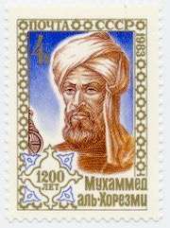
History
The earliest known algorithms were defined by Greek mathematicians
e.g. Euclid’s method for the greatest common divisor of two integers, ca. 300 BC
The modern word “algorithm” comes from the name of the Persian scholar Muḥammad ibn Mūsā al-Ḵwārizmī (ca. 780 -- ca. 850)
when his work was published in Latin his name was spelled Algoritmi
he was the author of several influential works on mathematics and natural science
his book on the systematic solution of linear equations contained several algorithms
the title of this book is also the source of our word “algebra”
USSR commemorative stamp (wikipedia.com)

Slide 18
A Laboratory for Computational Experiments
The main philosophy for the textbook is that the best way to learn computer science is to work on “lab projects”
Analogy -- labs in intro chemistry classes
instructor prepares the materials and methods
students follow instructions, write up a report and submit it
an advantage of computer labs: no nasty smells or messy explosions...
Hands-on experience with the subject is more effective than simply reading about it
What sorts of lab projects have you done in other science courses?
Why do science courses have labs?

Slide 19
PythonLabs
Lab projects use a programming language named Python
Python provides a “computational workbench”
you will be given example programs and data with detailed instructions for how to use them
you will run programs, modify them, see what they do, learn how they work
use these programs as a staring point for writing your own Python programs
Download an installer from www.python.org

Slide 20
Example: SieveLab
An old algorithm for making a list of prime numbers is known as the “Sieve of Eratosthenes”
One of the lab projects uses a Python program that implements the Sieve
>>> sieve(50) [2, 3, 5, 7, 11, 13, 17, 19, 23, 29, 31, 37, 41, 43, 47]
You will be able to track the progress of the computation as the computer builds the list
>>> a [None, None, 2, 3, 4, 5, 6, 7, 8, 9, 10, ...]
>>> sift(2,a); print(a) [None, None, None, 3, None, 5, None, 7, None, 9, None, ...]
Lab instructions will tell you what to type to make a list of primes and how to monitor the algorithm as the program runs

Slide 21
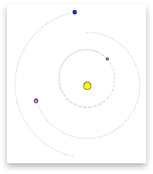
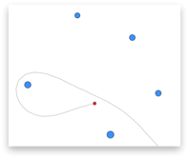
Example: SphereLab
Another lab project is based on a computation that predicts the locations of the planets in the Solar System
N-body problem: there are no equations that will specify future locations at arbitrary times
positions must be computed
Lab instructions tell you how to start a simulation that plots the locations of the Sun and planets
The lab software lets you set up your own experiments
a small change in the initial position of a body can significantly alter its final position

Slide 22
Projects for Beginning Programmers
The lab projects were designed for beginning programmers
The “tutorial exercises” in each chapter show how Python can be used to solve an interesting problem in computer science
these programs have already been written for you as examples
there are challenge projects that suggest ideas for how to modify or extend the programs
the end of each chapter also has additional programming exercises based on the material in the chapter

